Slide 1

Get it Done San Diego – Dashboard
Team: Git It On
UCSD Data Science and Visualization Bootcamp | Project 2

Slide 2
Team Git It On
Melissa Monroe | Architecture, design, data, Leaflet map, art
Andrew Bankston | Data, content, analysis, plots
Jacob Zacarias | Data, content, analysis, plots, maps
Annette Broeren | Powerpoint, Final Report, ReadMe

Slide 3
Goal: Dashboard for City of San Diego Get It Done App
Provide a dynamic dashboard for City of San Diego leadership
Identify problem-areas
Monitor and gage effectiveness of Get-It-Done program overall
Monitor and gage effectiveness of program by Council district
Metrics
Service request volume by period, type, council district
Average response time from open to closed
Open/closed deltas
service request volumes by type by council district
Cause and effect may require additional analysis outside the scope of this database.
Notes:
Tool to assist in determining if the program is successful in resolving issues in a timely manner, to monitor if certain districts are falling behind and require additional resources possibly certain times of year when service requests spike or dip, if the volume of certain service request types are increasing or decreasing by area, possibly indicating other issues such as gentrification, tourist season, etc.

Slide 4
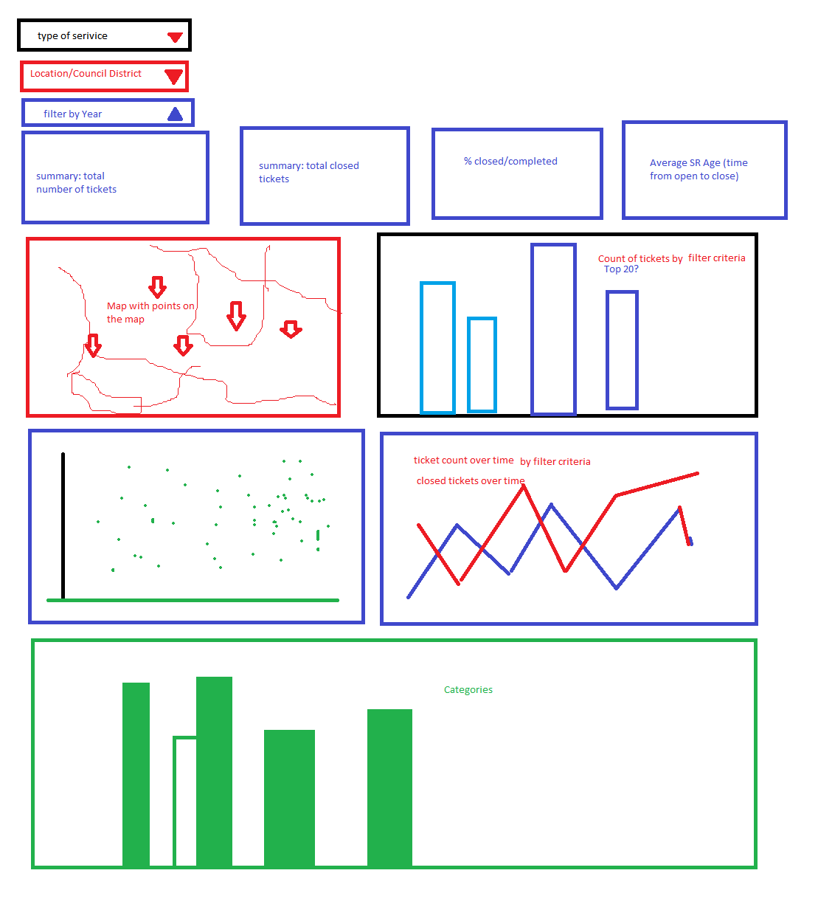
Concept
Freehand art by MM
Notes:
Initial concept dashboard: 3 selectors for time period, council district and ticket type, summary statistics, map, bar, bar, scatter, plot and line charts.

Slide 5
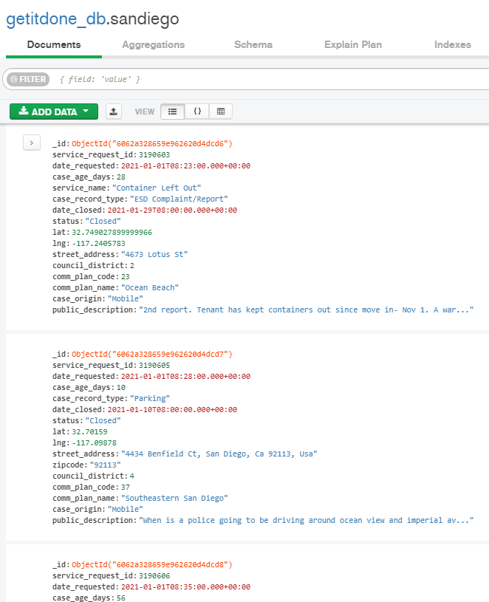
Source data
City of San Diego Get It Done program files: https://data.sandiego.gov/datasets/get-it-done-311/
Get It Done Requests JSON API – json
Get It Done Requests year-to-date – csv
Get It Done Requests 2020 – csv
Get It Done Requests 2019 – csv
Get It Done Requests 2018 – csv
Get It Done Requests 2017 – csv
Get It Done Requests 2016 – csv
City Council Districts geoJson: https://data.sandiego.gov/datasets/city-council-districts/
~700,000 documents

Slide 6










Process
Data collecting
Processing
Routes
Visualization
Deployment
Today

Slide 7
Dependencies
Flask – Routes
import os from flask import (Flask, render_template, jsonify, request, redirect) import pymongo from src import config from bson.json_util import dumps import json import requests import dns import datetime from datetime import datetime import pytz from django.utils import timezone from flask import CORS
Jupiter Notebook– Data gathering
import requests import pymongo import dns import datetime from datetime import datetime from dateutil import parser import pytz from django.utils import timezone from time import sleep import json import config import requests #Project defined dependencies import config from pprint import pprint
DNS – enables connection to Atlas MongoDB
Flask CORS – cross origin resource sharing (enables running API calls when origin is different from web origin)
pytz – accurate cross-platform time calculation
Django - stores datetime information in UTC, uses time-zone-aware datetime objects internally, and translates them to the end user’s time zone
Jupiter Notebook – Visualizations
from matplotlib import pyplot as plt import pandas as pd #Project defined modules import config import visualization as viz
Python – Class Visualizer
import pymongo import dns import datetime import json import pandas as pd import numpy as np from matplotlib import pyplot as plt import config

Slide 8
Observations

Slide 9
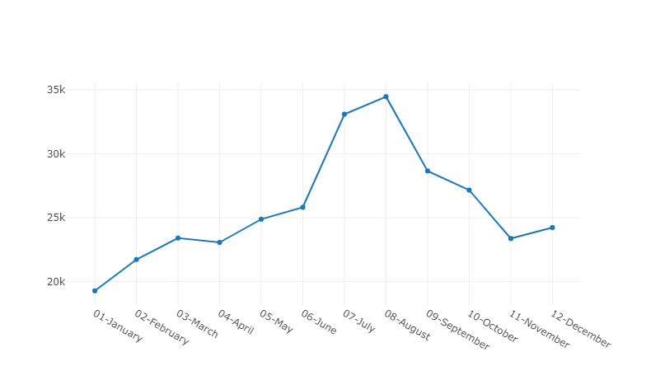
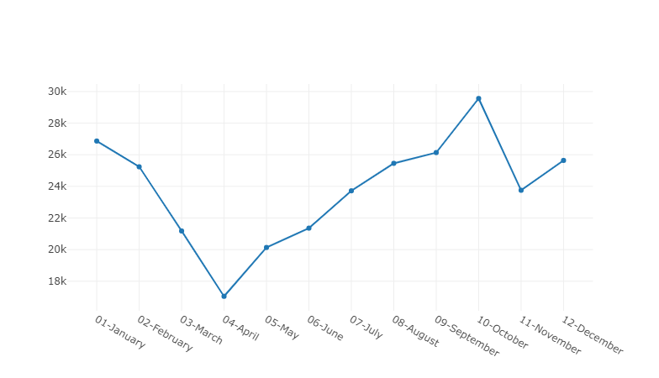
Number of service requests by year – Plotly
In 2019, service requests peeked in July and August. District data should be verified to see if spikes could possibly occur in more popular tourist areas.
In 2020, service requests dipped significantly in April which correlates with the start of COVID-19 restrictions, and peeked in October.
2019 Get It Done service requests
2020 Get It Done service requests

Slide 10
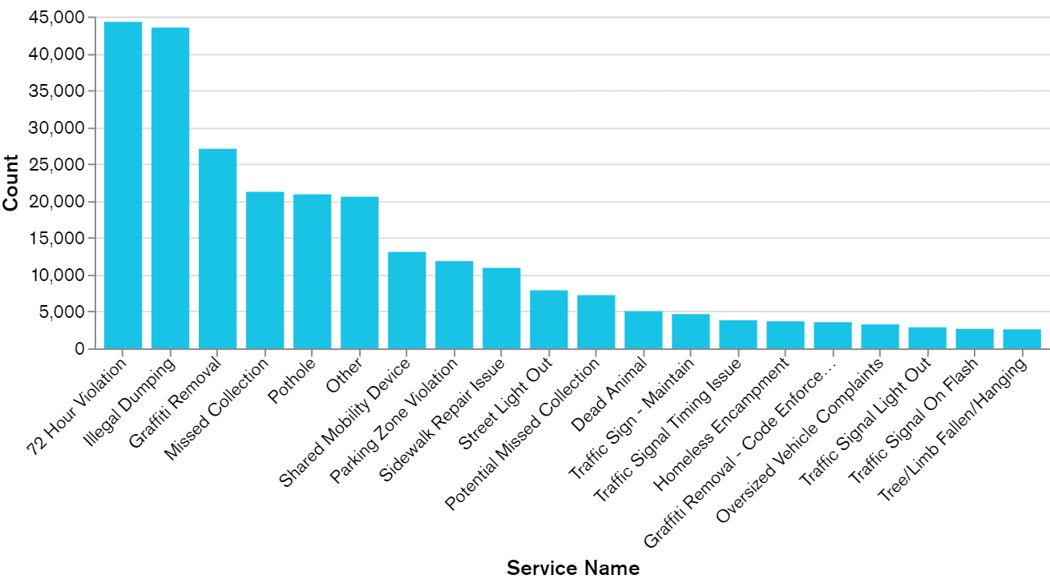
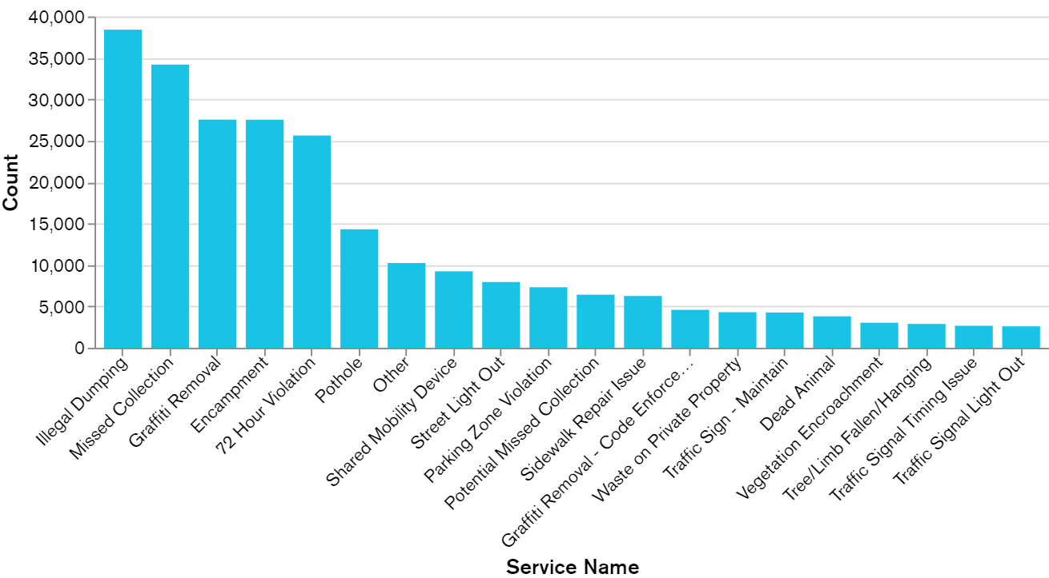
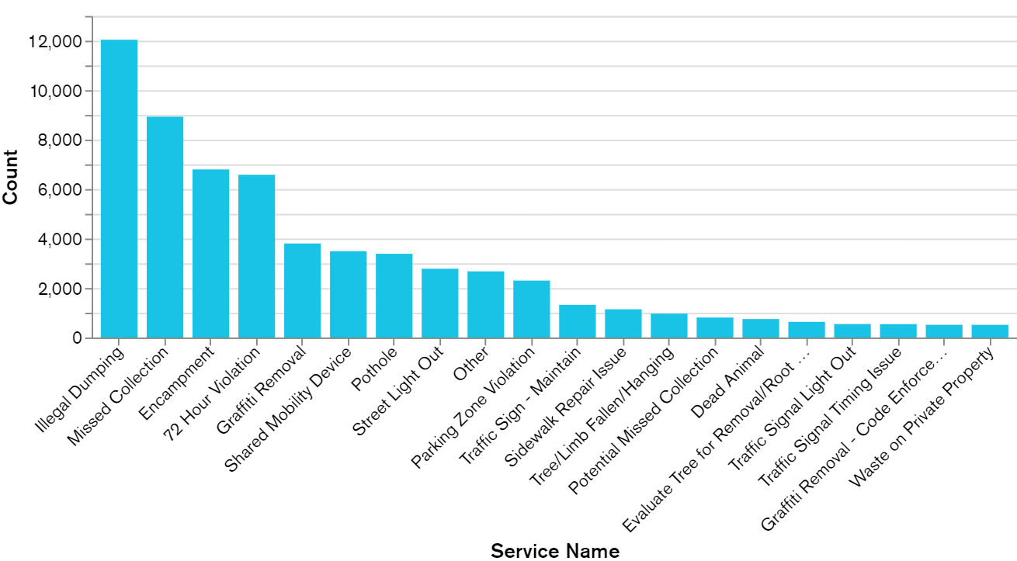
Service types
2019
Service Type | 2019 | 2020 | 2021 | Trend
Illegal Dumping | 44K | 38K | 12K | 
Missed Collection | 21K | 34K | 9K | 
Encampment | 4K | 27K | 7K | 
2020
Since 2019, illegal dumping has been the most popular service request in the City of San Diego. Further analysis is required to see if locations of the occurrences are repetitive or clustered.
Missed collections is experiencing a significant increase since 2019 and is still trending upwards. Council district data should be reviewed to determine if this is a city-wide trend or if this is occurring in specific areas. Possible remedies could be additional training if the issue is area-specific, or additional resources if the issue is city-wide.
2021

Slide 11
Council Districts Performance
Council Districts | 2019 | 2020 | 2021 to date
Most tickets | District 3 (75K) | District 3 (66K) | District 3 (25K)
Fewest tickets | District 5 (10K) | District 5 (10K) | District 5 (3K)
Average case length across districts | 46-60 days | 20-35 days | 10-16 days
Longest average case length | District 5 (70 days+) | District 5 (40 days+) | District 5 (21 days+)
The data shows that the Council District with the fewest tickets has the longest average case length. Further review disclosed that District 5 has several long-duration ticket types that possibly skew the average case length:
Evaluate for resurfacing: 280 cases at 400 days to close
Sidewalk repair issues: 750 cases at 200 days to close
It is recommended to remove the above items from the data and reevaluate the average case length of District 5. If the data still shows a significant higher average case length, possible culprits such as high volume tickets should be reviewed to determine if there are training or resource issues.
District 3 is Old Town to Balboa Park, Downtown to Hillcrest, Mission Hills to University Heights.
District 5 is Black Mountain Ranch, Carmel Mountain Ranch, Miramar Ranch North, Rancho Bernardo, Rancho Encantada (Stonebridge), Rancho Peñasquitos, Sabre Springs, San Pasqual, Scripps Ranch and Torrey Highlands.

Slide 12
Going forward

Slide 13
Opportunities to Add Value: Performance Indicators
Volume of service requests by category by year / quarter / area
Is volume of service requests evenly distributed by area?
Do certain areas have a noticeably smaller or larger number of service requests in any category?
Is the volume of service requests steady or are there dips/spikes?
Are dips/spikes occurring during certain times of the year? Certain districts?
Average days from open to close, grouped by category, by council district compared to overall
Is average time to resolve a service request same across categories? Across districts?
Dips/spikes? Certain areas? Certain times of year?
Group the data by major categories (less then 20) instead of every category

Slide 14
Issues
Github. ‘Cause … always.
Loading the data into the dashboard can be slow
Leaflet map did not populate correctly and required significant research and rework
The MongoDB document date-fields did not populate correctly in the tooltip

Slide 15
Appendix

Slide 16
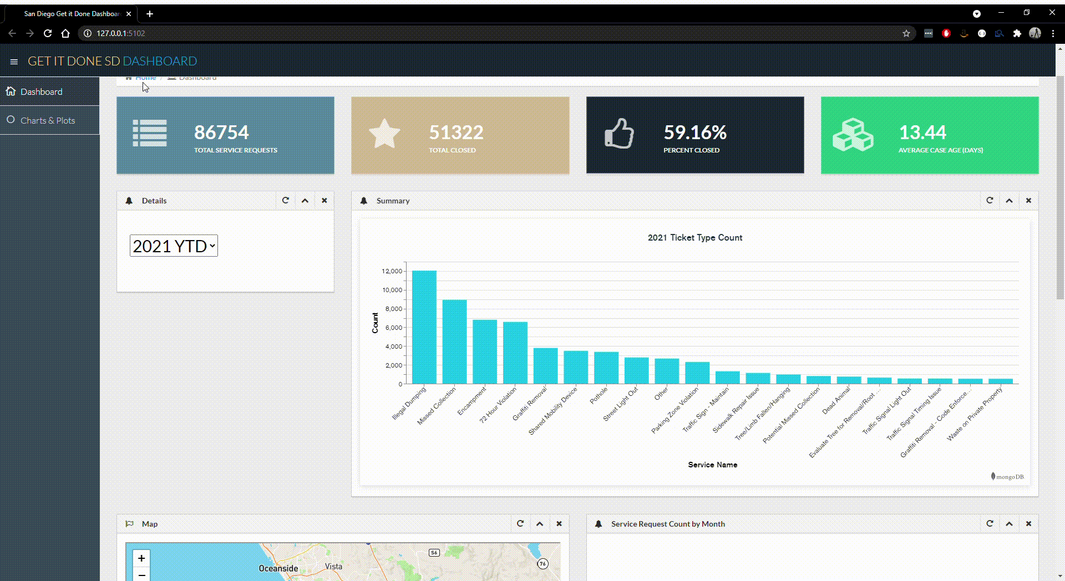
Dashboard – Production

Slide 17
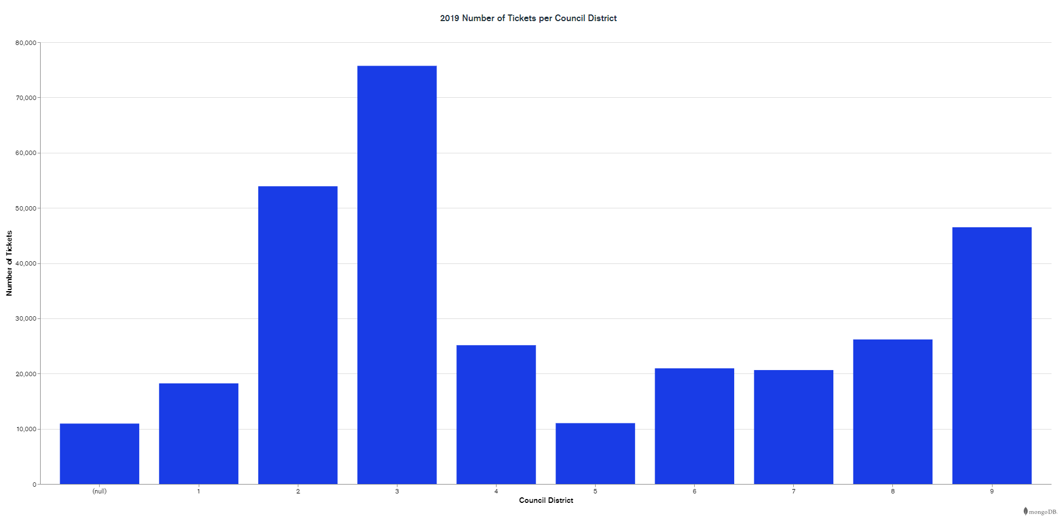
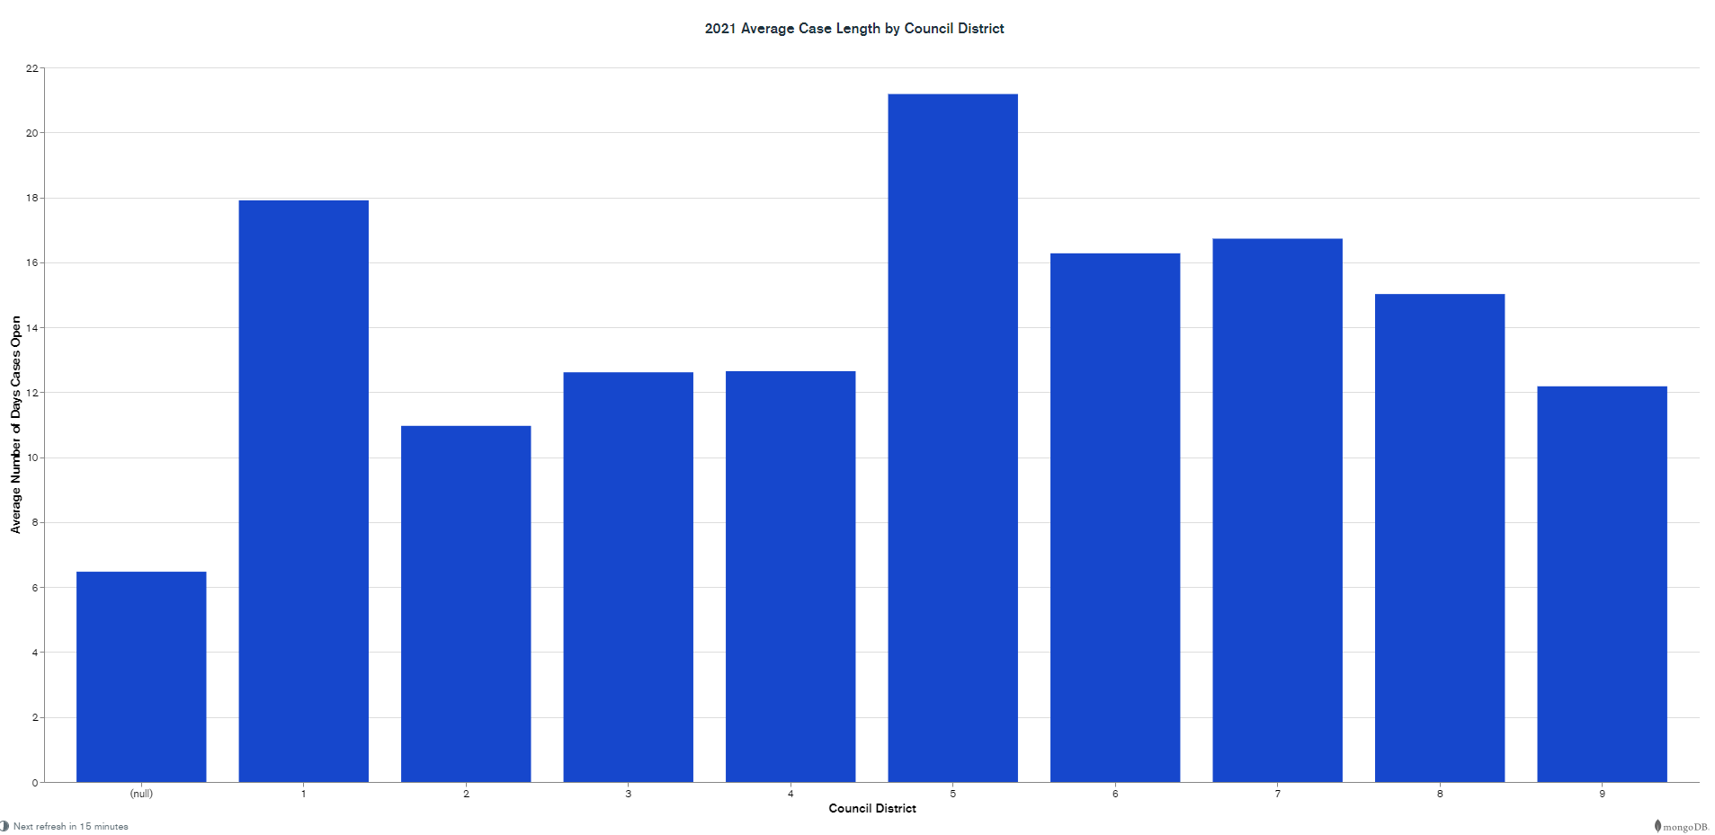
Dashboard Features for San Diego Get It Done Database
Year selector
Summary Status at a glance
Service requests by service type
Leaflet mapbox with popup tool tip and filter (service type, limit)
Service request count by month
Top 20 service requests by type
Service requests by council district
Average case length by council district

Slide 18
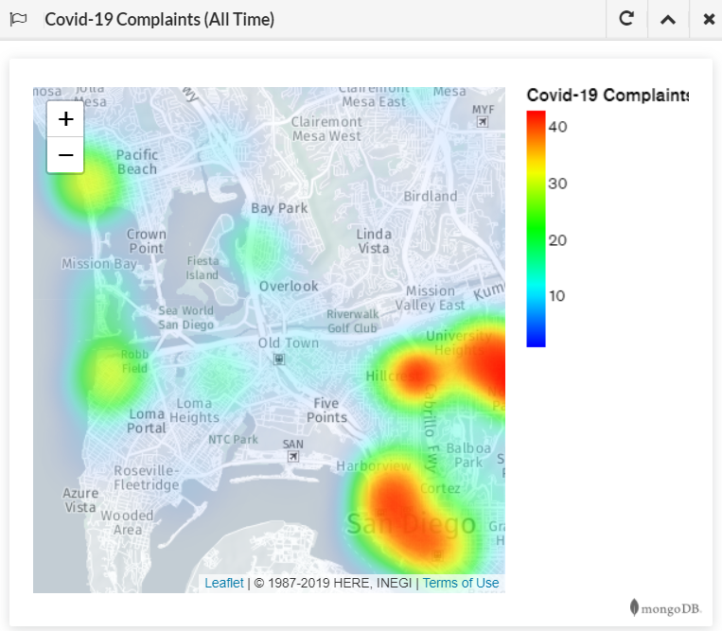
COVID-19 Heat Map
MongoDB Charts

Slide 19
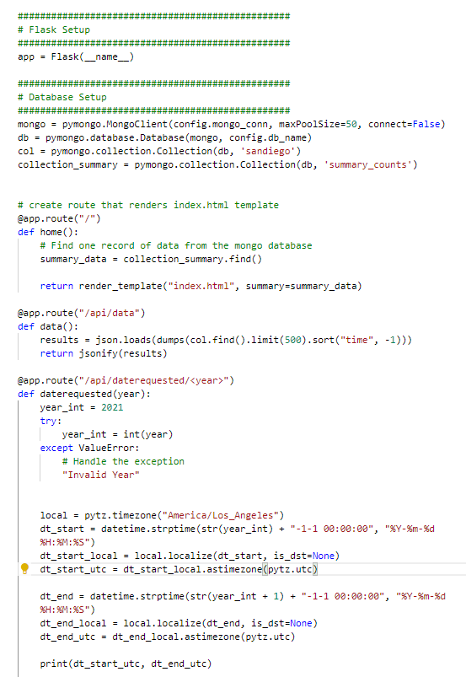
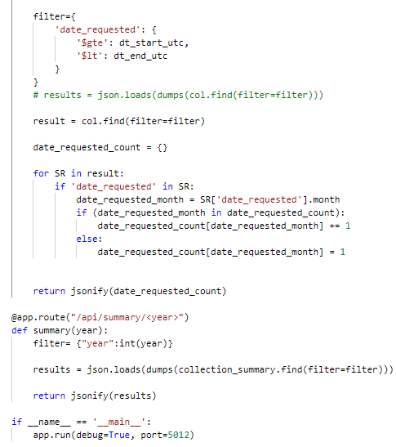
App.py
Flask

Slide 20
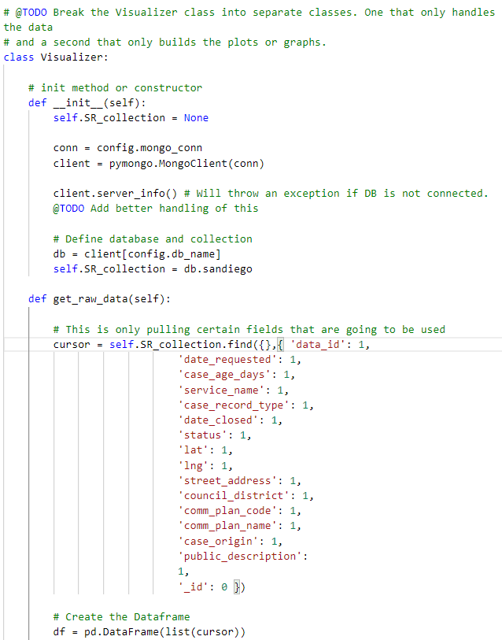
Visualization.py

Slide 21
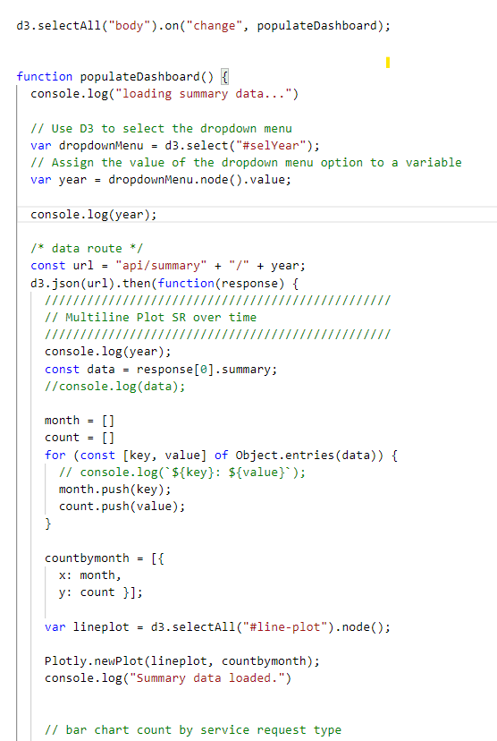
App.js
Populate dashboard

Slide 22
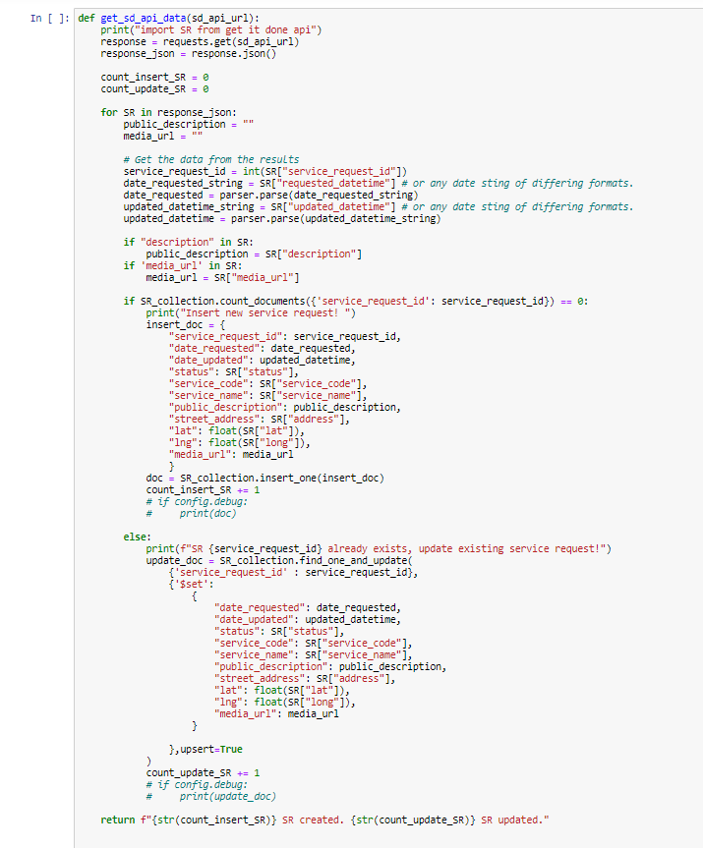
Main.ipynb
API Data

Slide 23
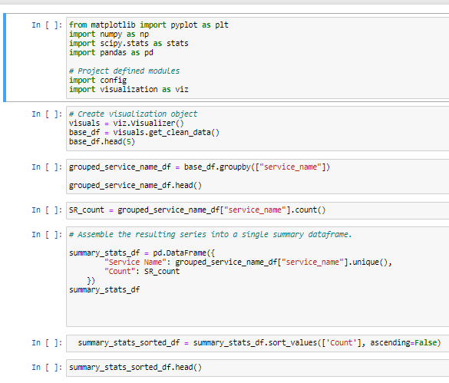
Visualization.ipynb

